Slide 1

Ethical Bias Home Mortgage Disclosure Act
Nish Sule, Bryan Tamsir, Victor Yu, Xianyuan Zhou, Xin Zou

Slide 2
AGENDA
DATA PREPARATION
MODELS EVALUATION
Bias and Discrimination
SUMMARY
MODELS
Notes:
The Utility-Fairness Tradeoff
Load Data
Measure Social Bias
Establish Baseline Metrics
Naive Fairness-aware Approach: Remove Protected Class
Fairness-aware Method: Relabelling
Fairness-aware Method: Additive Counterfactually Fair Model
Fairness-aware Method: Reject-option Classification
Comparison of Fairness-aware Techniques
A simple classification ML pipeline consists of five steps:
data ingestion,
data preprocessing,
model training,
model evaluation,
prediction generation on new examples.

Slide 3
Research Questions
Can we identify intrinsic bias within our dataset?
Can we mitigate the bias while maintaining or improving a machine learning model’s predictive accuracy?
Notes:
As more industries integrate machine learning into socially sensitive decision processes like hiring, loan-approval, and parole-granting, we are at risk of perpetuating historical and contemporary socioeconomic disparities. This is a critical problem because on the one hand, organizations who use but do not understand the discriminatory potential of such sys- tems will facilitate the widening of social disparities under the assumption that algorithms are categorically objective. On the other hand, the responsible use of machine learning can help us measure, understand, and mitigate the implicit historical biases in socially sensitive data by expressing im- plicit decision-making mental models in terms of explicit statistical models. In this paper we specify, implement, and evaluate a “fairness-aware” machine learning interface called themis-ml, which is intended for use by individual data sci- entists and engineers, academic research teams, or larger product teams who use machine learning in production sys- tems.
The overall goal of this research is to come up with a reasonable way to think about how to make machine learning algorithms more fair. While the mathematical formalization of fairness is not sufficient to solve the problem of discrimination, our ability to understand and articulate what it means for an algorithm to be fair is a step in the right direction.
1.Measure the degree of discrimination in the dataset with respect to some discrimination metric and protected class.
2.Establish a baseline performance level with respect to utility and fairness metrics with models trained on a fairness-unaware machine learning pipeline.
3.Measure and compare the baseline metrics with fairness aware models.
Our contributions in this paper are three-fold. First, we pro- pose an application programming interface (API) for“Fairness- aware Machine Learning Interfaces” (FMLI) in the context of a simple binary classifier. Second, we introduce themis-ml, an FMLI-compliant library, and apply it to a hypothetical loan-granting DSS using the German Credit Dataset [14]. Finally, we evaluate the efficacy of themis-ml as a tool for measuring potential discrimination (PD) in both training data and ML predictions as well as mitigating PD using fairness-aware methods. Our hope is that themis-ml serves as a reference implementation that others might use and extend for their own purposes.
Bias can lead to intended/unintended discrimination.
Fair models often make less accurate predictions which is important for businesses to evaluate for their respective purposes (Bantilan 2017.)

Slide 4
DATA DESCRIPTION
11.7 million loan records reported by 7,062 financial institutions in 2014.
25 variables
Loan type, Property type, Action type…
Notes:
(4750186, 53)
11.7 million loan records
Loan type
Property type
Applicant’s race, ethnicity, gender and income
Co-Applicant’s race, ethnicity, and gender
Purpose of the loan application
Outcome of the loan application
Loan amount
Applicant’s income
Geographical information

Slide 5
TARGET VARIABLE
8
Original
3
Selected
2
1 = Originated
0 = Denied
ACTION_TYPE
Notes:
1 -- Loan originated
3 -- Application denied by financial institution
7 -- Preapproval request denied by financial institution
1 -- Loan originated 2 -- Application approved but not accepted 3 -- Application denied by financial institution 4 -- Application withdrawn by applicant 5 -- File closed for incompleteness 6 -- Loan purchased by the institution 7 -- Preapproval request denied by financial institution 8 -- Preapproval request approved but not accepted (optional reporting)

Slide 6
PROTECTED CLASSES
Age
Race
National Origin
Religious Beliefs
Gender
Disability
Pregnancy
Veteran Status

Slide 7
PROTECTED CLASSES IN OUR DATA
Applicant’s race, ethnicity, gender.
Co-Applicant’s race, ethnicity, and gender.

Slide 8
Research Questions #1
Can we identify intrinsic bias within our dataset?

Slide 9

WHY RACE?
Notes:
Race:1 to 5 presents 5 different races.
#1 -- American Indian or Alaska Native
#2 -- Asian
#3 -- Black or African American
#4 -- Native Hawaiian or Other Pacific Islander
#5 – White

Slide 10
MEASURE SOCIAL BIAS
Group-level discrimination.
Difference between advantaged class and disadvantaged class.
Values range from -1 to 1.
Mean Difference
Notes:
In the context of measuring group-level discrimination, describes mean difference and normalized mean difference. Mean difference measures the difference between p(a ∪ y+) and p(d ∪ y+). Values range from -1 to 1, where -1 is the reverse-discrimination case (all Xa have y− labels and all Xd have y+ labels) and 1 is the fully discriminatory case (all Xa have y+ labels and all Xd have y− labels). Normal- ized mean difference, which also takes on values between -1 and 1, scales these values based on the maximum possible discrimination in a dataset given the rate of positive labels
Values range from -1 to 1.

Slide 11
Mean Difference
Disadvantaged Class | Advantaged Class
RACE_1: 12.54% - 95% CI [11.68, 13.40] | RACE_2: -0.08% - 95% CI [-0.39, 0.23]
RACE_3: 17.82% - 95% CI [17.46, 18.17] | RACE_5: -8.52% - 95% CI [-8.75, -8.29]
RACE_4: 8.43% - 95% CI [7.37, 9.48]
Notes:
RACE_ia: 12.54 - 95% CI [11.68, 13.40]
RACE_asian: -0.08 - 95% CI [-0.39, 0.23]
RACE_afa: 17.82 - 95% CI [17.46, 18.17]
RACE_nh: 8.43 - 95% CI [7.37, 9.48]
RACE_white: -8.52 - 95% CI [-8.75, -8.29]
These mean differences and confidence interval bounds suggest that on average:
men have "good" credit risk at a 7.48% higher rate than women, with a lower bound of 1.35% and upper bound of 13.61%.
citizen workers have "good" credit risk at a 19.93%higher rate than foreign workers, with a lower bound of 4.91% and upper bound of 34.94%.
people above the age of 25 have "good" credit risk at a 14.94% higher rate than those below 25 with a lower bound of 8.97% and upper bound of 25.61%.

Slide 12
Research Questions #2
Can we mitigate the bias while maintaining or improving a machine learning model’s predictive accuracy?

Slide 13
SETUP BEFORE TRAINING
Y
X
S
Action(1= Originated, 0=Application denied)
Loan Type, Purpose, Annual Income...
Race (0= advantage group, 1=disadvantage group)
Notes:
y= Action (1= Originated, 0=Application denied by financial institution, Pre-approval request denied by financial institution)
X= Loan Type, Purpose, Annual Income...
s= Race (0= advantage group, 1=disadvantage group)

Slide 14
Experimental Procedure
Baseline
Remove Protected Attribute
Relabel Target Variable
Reject-option Classification
B
RPA
RTV
ROC
Notes:
Baseline (B): Train a model on all available input variables in the German Credit dataset, including pro- tected attributes.
Remove Protected Attribute (RPA): Train a model on input variables without protected attributes. This is the naive fairness-aware approach.
Relabel Target Variable (RTV ): Train a model using the Relabeling fairness-aware method.
Reject-option Classification (ROC ): Train a model using the Reject-option Classification method.
To assess the extent to which (i) a model trained on these data mirrors these PD credit risk distributions, and (ii) fairness-aware techniques can reduce these methods, we used mean difference to measure model fairness and AUC to mea- sure model utility. For this experiment we specify five con- ditions:
Table 3: Potentially discriminatory target variable distri- bution. md = mean difference, nmd = normalized mean difference.
For each of these conditions, we train LogisticRegression, DecisionTree, and RandomForest model types using 10-fold cross validation; generate train and test predictions; and compute AUC and mean difference metrics for each train- test pair. We then compute the mean of these metrics for each condition and model type. The code for this analysis is available on github.

Slide 15
Fairness Aware Methods
Remove protected variable
Remove variable Race
Pre-processing
More approval to disadvantage group
Less approval to advantage group
Relabelling
Post-Processing
Reject Option Classification
Modify the predicted probability

Slide 16
ESTIMATORS
DECISION TREE
Logistic Regression
Random Forest

Slide 17
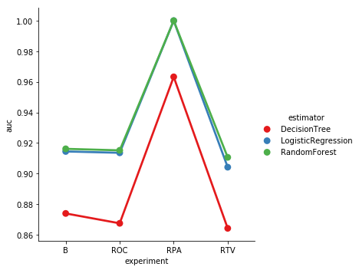
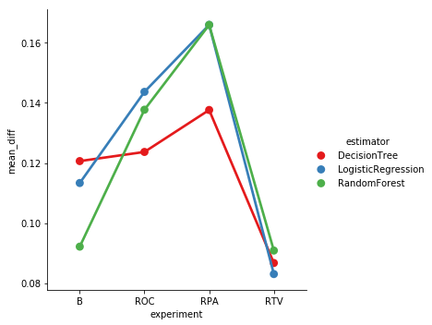
MODEL EVALUATION

Slide 18
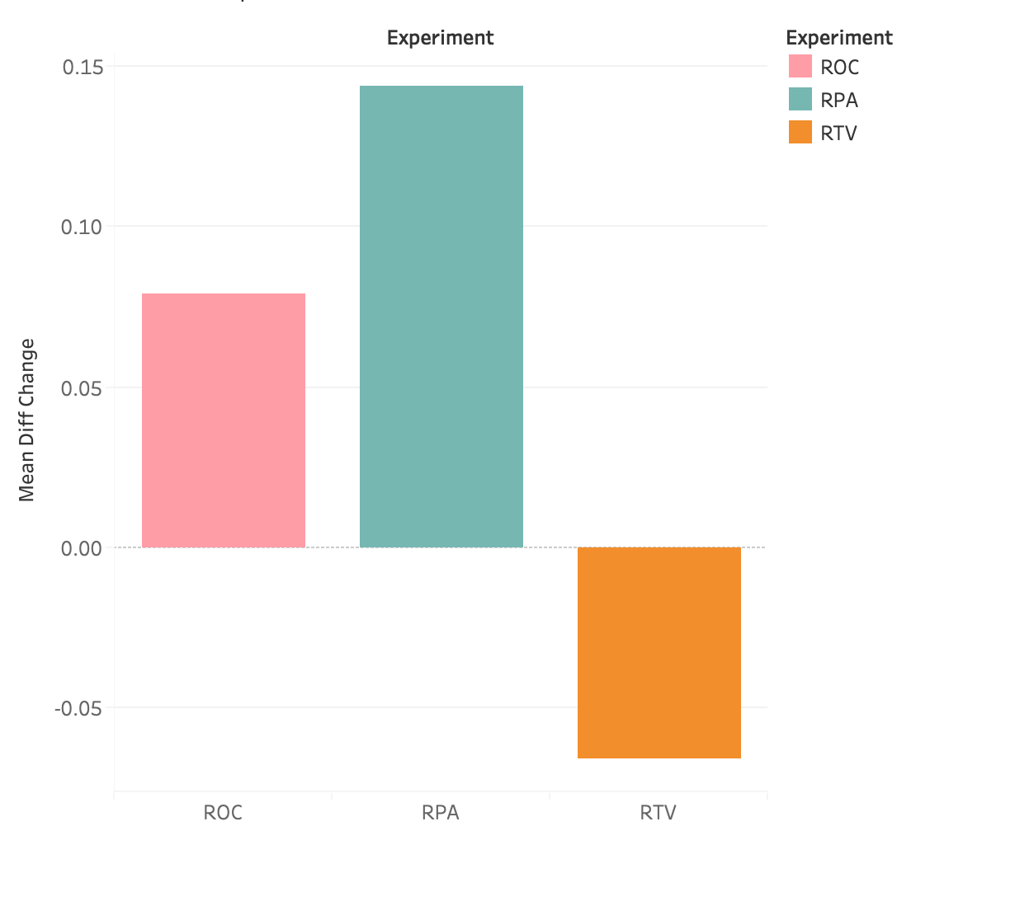
RESULTS COMPARISON

Slide 19
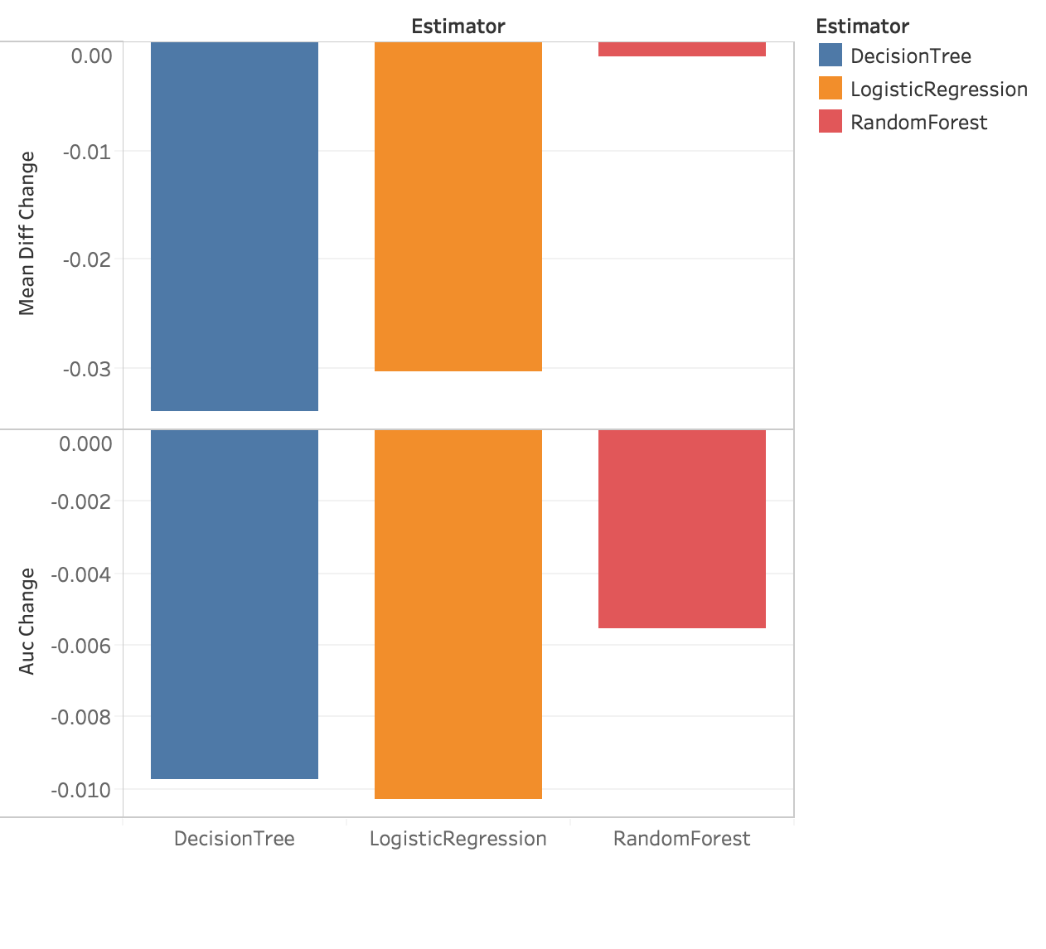
RESULTS COMPARISON

Slide 20
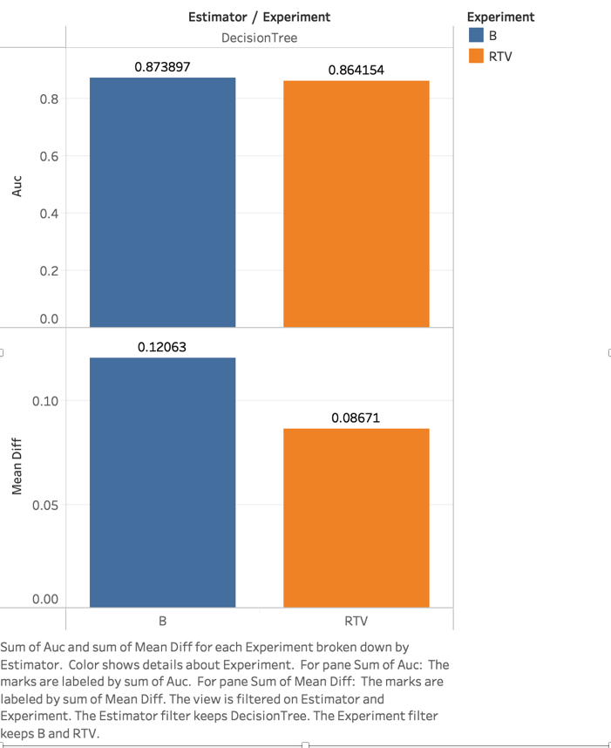
RESULTS COMPARISON

Slide 21
CONCLUSION
Decision Tree
RTV
RTV

Slide 22
CHALLENGES
Results changes every time.
ROC’s bad performance.
Solution:
Increase size of sample data set.
Increase number of splits and repeats.
Cause:
The limitation is that model types must be able to produce predicted probability.
Notes:
The reason for this issue may be either we decreased the size of sample or decrease the # of repeats for faster running speed.
Increase the size in a reasonable amount. We combined all the data from each state in the whole file and take 0.4 of them as sample
Increase the number of splits to achieve a stable outcome.
Only suitable to used on logistic models, not decision tree or random forest.

Slide 23
TAKEAWAY
We are at risk of implicating historical biases in socially sensitive data and influence our decision-making.
We use mean difference to measuring the degree of discrimination in the dataset with respect to some discrimination metric and protected class.
We can use Themis-ml package to make a fairness-aware ML Interface. There are several methods including Baseline, Remove Protected Attribute, Relabel Target Variable.
The fairness-utility trade-off can help machine learning practitioners and researchers determine which methods are suitable for their particular data context.
Notes:
We learned. Why we need to consider ethics bias when applying ML?
How to detect bias?
What methods can we use?
How to interpret the outcomes?
1 As more industries integrate machine learning into socially sensitive decision processes.

Slide 24
THANK YOU

Slide 25
Q & A

Slide 26
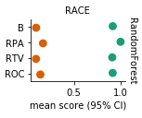
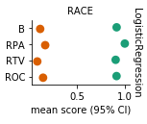
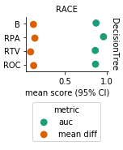
Fairness-aware Methods
Notes:
Comparison of Fairness-aware Methods

Slide 27
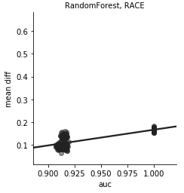
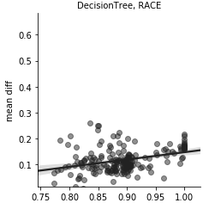
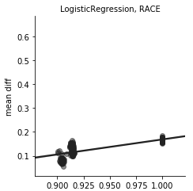
SUMMARY
Notes:
Correlation between AUC and Mean Dif- ference

Slide 28
